Slide 1
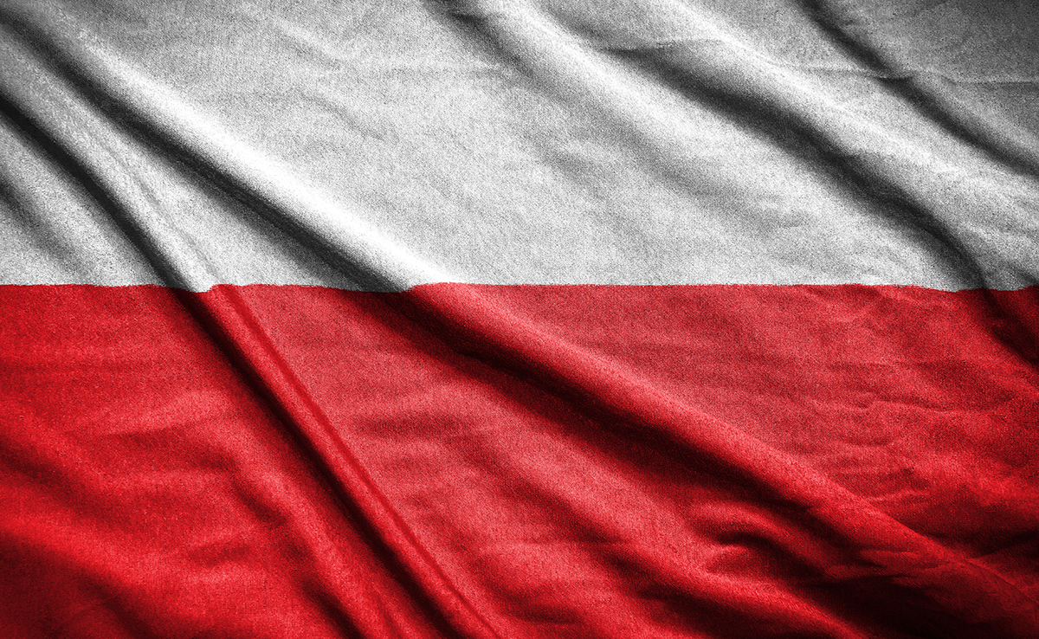
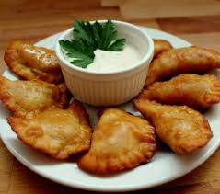
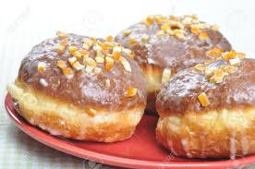
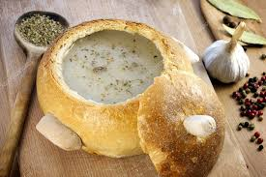
Typical Polish food

Slide 2
IMPORTANT comment
In Poland it is hard to say ,,traditional Polish cuisine’’ , because since last century people in different regions eat different food. For Polish from South typical food will be dissimilar to people who come form North.

Slide 3
Different kinds of cuisine in Poland

Slide 4
Polish cuisine
Polish cuisine is one of the most unique like one-of-a-kind cuisine in the whole world. There isn’t another one where people eat such different things
like BARSZCZ UKRAIŃSKI, RUSKIE PIEROGI or CHŁODNIK LITEWSKI.

Slide 5
Barszcz ukraiński
A soup made of beetroots with red bean and potatoes. This soup comes from Ukraine. Now it is one of the most popular soups in Poland.

Slide 6
Pączek – A doughnut
A cake with some jam inside. You can find it in every shop in Poland. People eat it even at the job or school.

Slide 7
SPICES
If you want that your food tastes good you have to use a lot of spices like people do it in Poland.

Slide 8
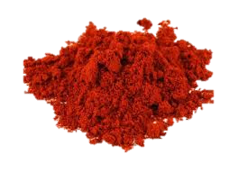
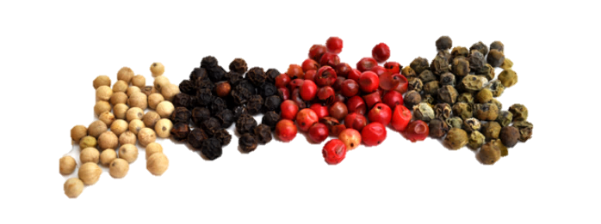
The most popular spices which we use
smoked pepper
lovage
pepper

Slide 9
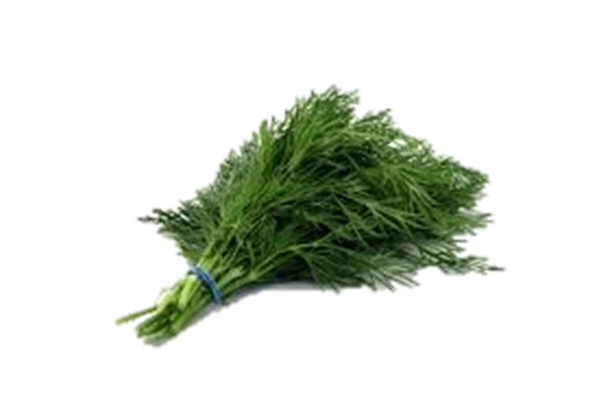
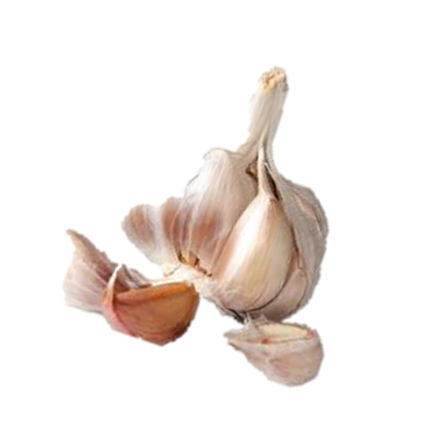
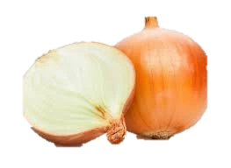
bay leaf
dill
onion
garlic

Slide 10
Typical Polish dishes are connected with religion, holidays and traditions.
For example on the Christmas Eve (during the year also) people eat:

Slide 11
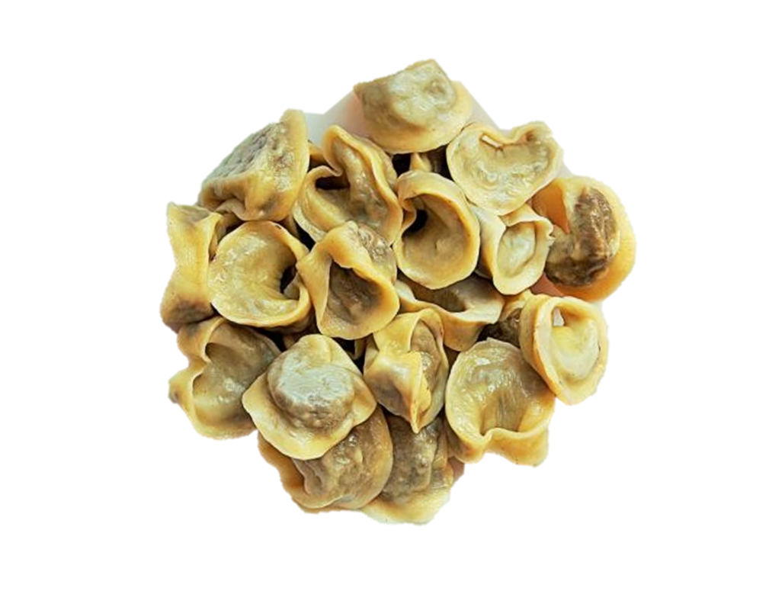
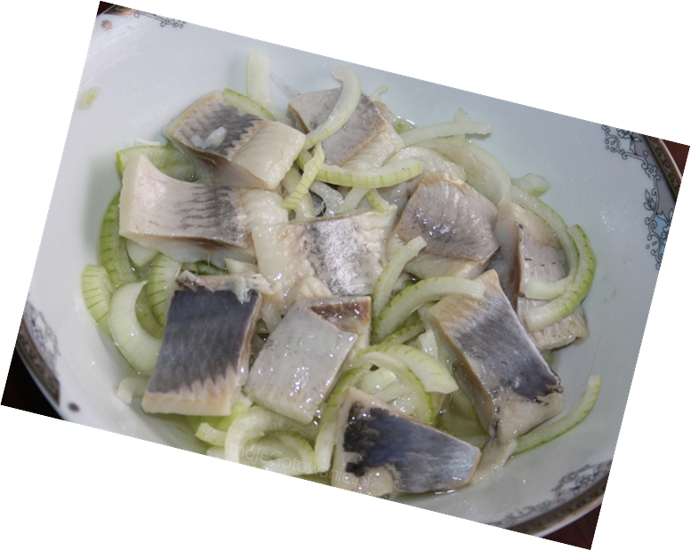
Uszka (little dumplings with cabbage and mushrooms inside)
herrings

Slide 12
EXAMPLES OF DISHES WHICH PEOPLE EAT DURING THE NORMAL WEEK FOR Dinner
Rosół – soup made of chicken and vegetables. There is no person in Poland who doesn’t eat rosół.

Slide 13
Potates, meat and salad made of cucumbers with some cream

Slide 14
Pierogi –dumplings with stuffing

Slide 15
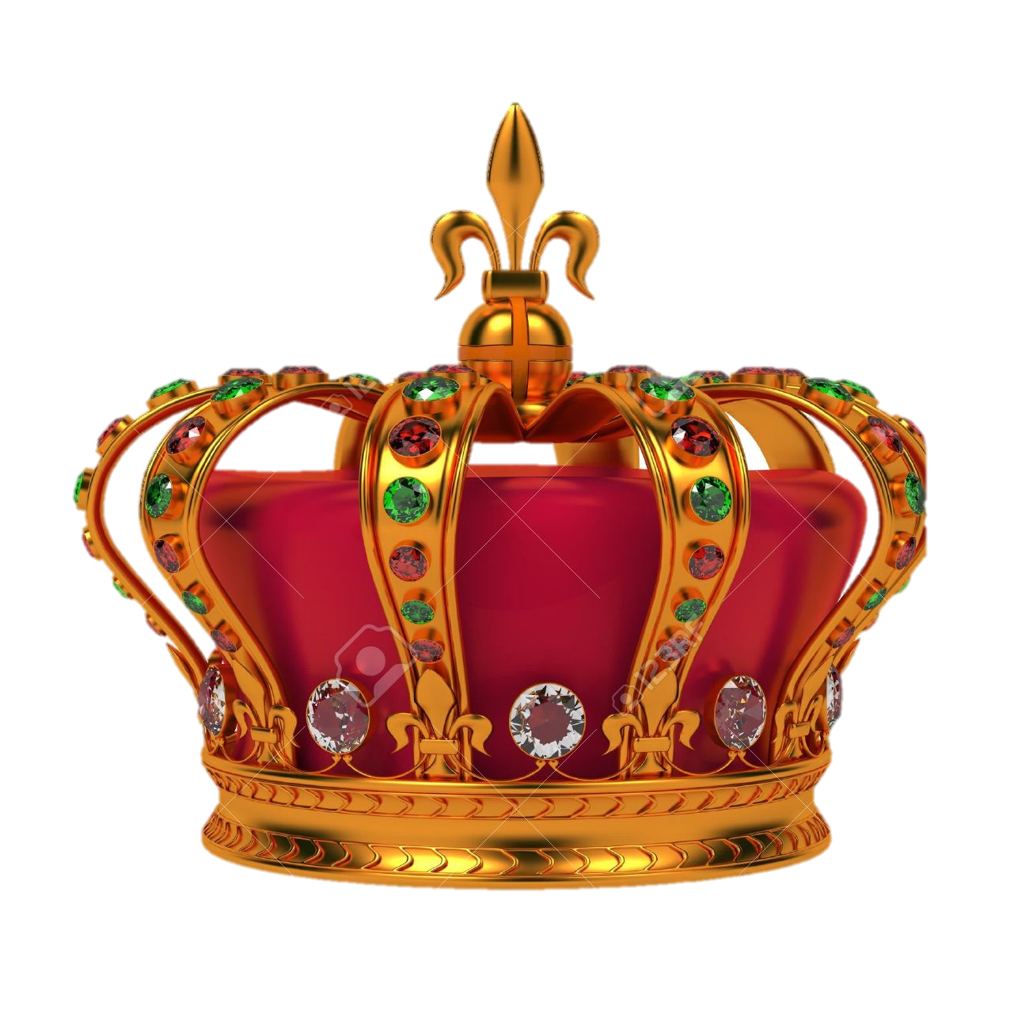
The king of Polish cuisine is POTATOE. Almost evry Polish dish is made of potatoes.

Slide 16
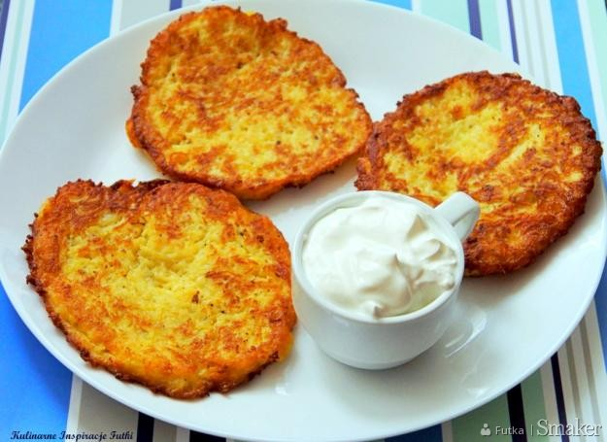
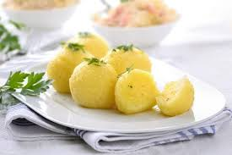
Fried mashed potates called Placki ziemniaczane
Pyzy – boiled potatoes with flour and egg
Kopytka – boiled dumpling made of potatoes.

Slide 17
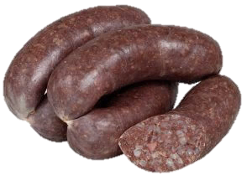
We also have some strange food
Kaszanka - groats with pig’s blood
Galareta – jelly with eggs and meat inside

Slide 18
We hope that now you know our cuisine a little bit better. Thanks for your attention.

Slide 19
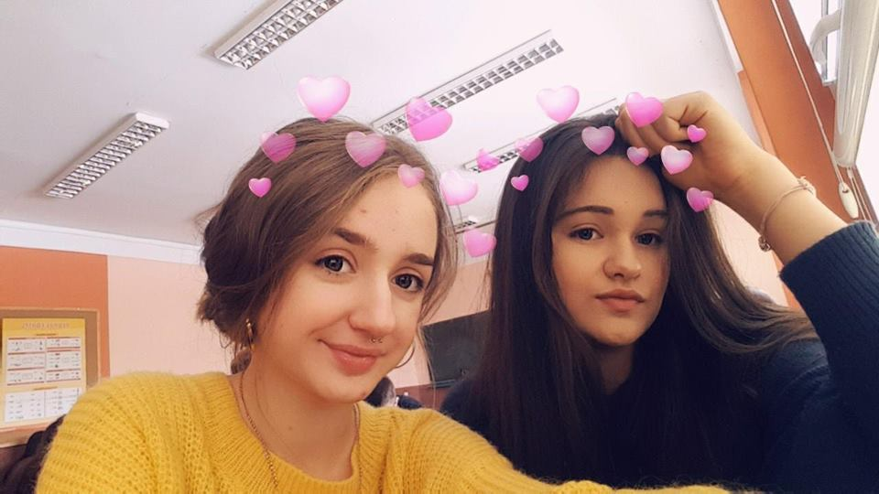
Justyna Słonka and Alicja Sałamun

