Slide 1
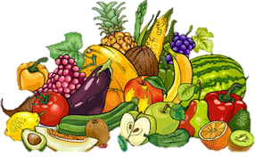
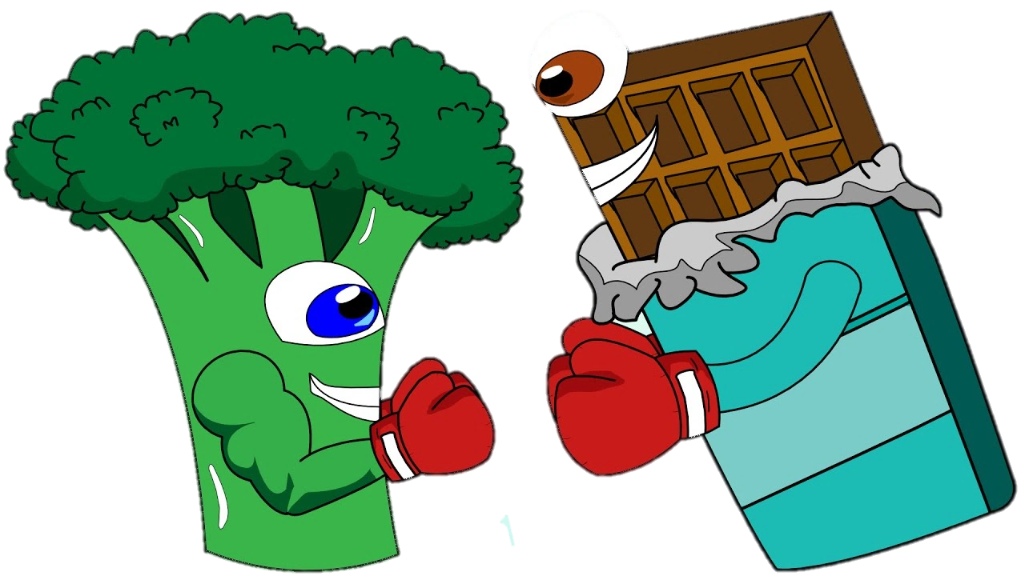
Healthy food

Slide 2
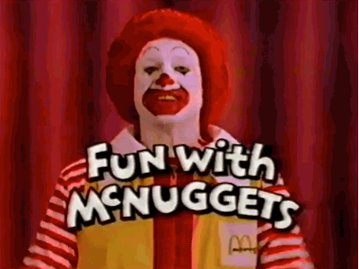
We have to be honest. Most people don’t eat healthy food. Fortunately eating fruit and vegetables becames more and more popular. We try to cook new things with lots of modern ingredients, but it is hard when near us we can find KFC, SUBWAY, MC’DONALDS OR STARBUCKS.

Slide 3
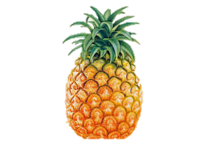
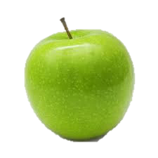
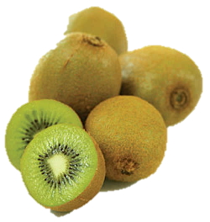
What should we remember about?
Eat as many meals as you need during the day
Dont eat when you are not hungry
Try new things
Don’t go to the places like Pizza Hut!! The most important thing - you are what you eat, so maybe it is time to change your eating habits?

Slide 4
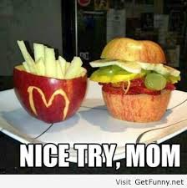
When we eat healthy food we feel good!
We need to stop looking at fast food. We’ve got lots of opportunities instead. In this presentation we will show you these options.

Slide 5
SHAKES
Have you ever heard about shakes or smoothies? It is very fast and yummy. You can mix different fruit with for example cow milk, plant milk, water or juice. People should eat 5 meals during the day so in the morning you can prepare something like that.

Slide 6
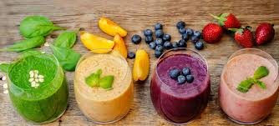

Slide 7
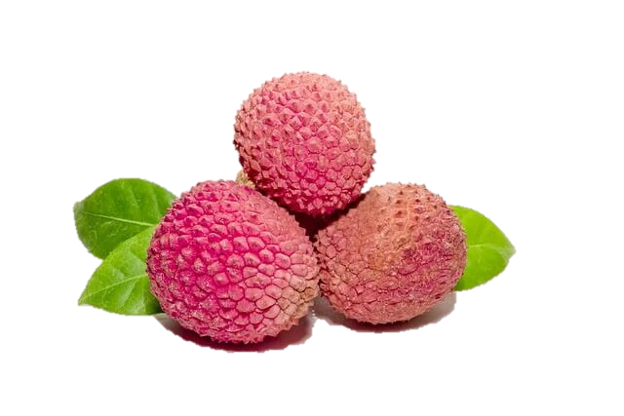
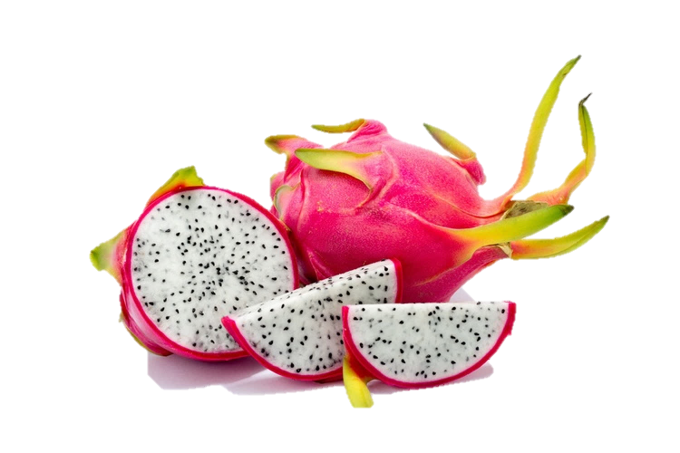
FRUIT
There are so many kinds of fruit which you can try. Just look :
lichee
Pitaja

Slide 8
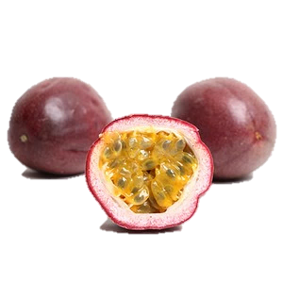
kaki
passion fruit

Slide 9
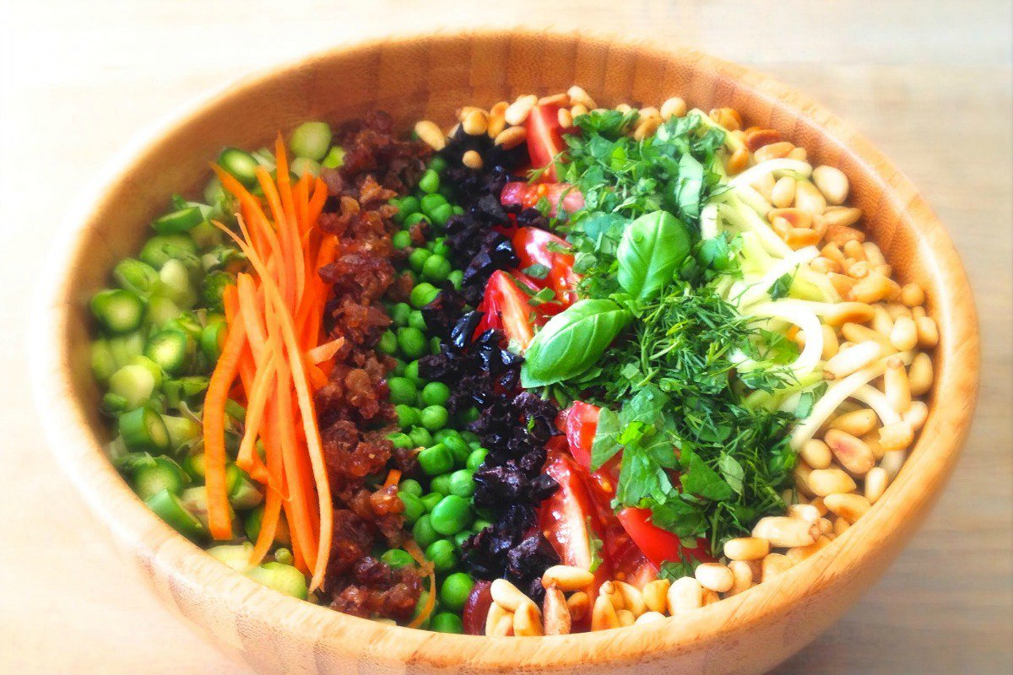
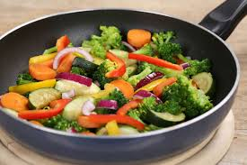
Vegetables
Vegetables are awesome idea for dinner. After eating vegetables you will not be hungry in next few hours.

Slide 10
We all have the internet at houses. So instead of playing games or watching youtube find something interesting about food. Maybe some recipies?

Slide 11
Why eating healthy is so important?
Our body is changing during the whole life. We need to understand that we have to eat good quality food! When we will spend our life at the restaurants eating fries, at the age of 30 we will fell like seniors ☹.

Slide 12
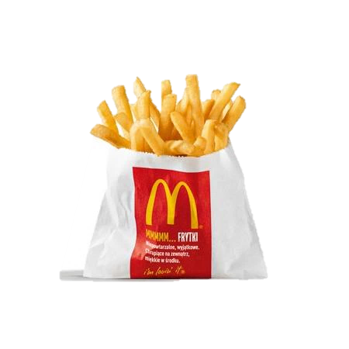
Change food which you eat everyday at more healthy option
fried
baked

Slide 13
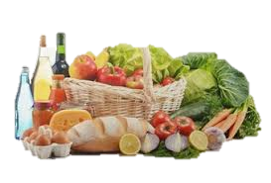
Less artificial food

Slide 14
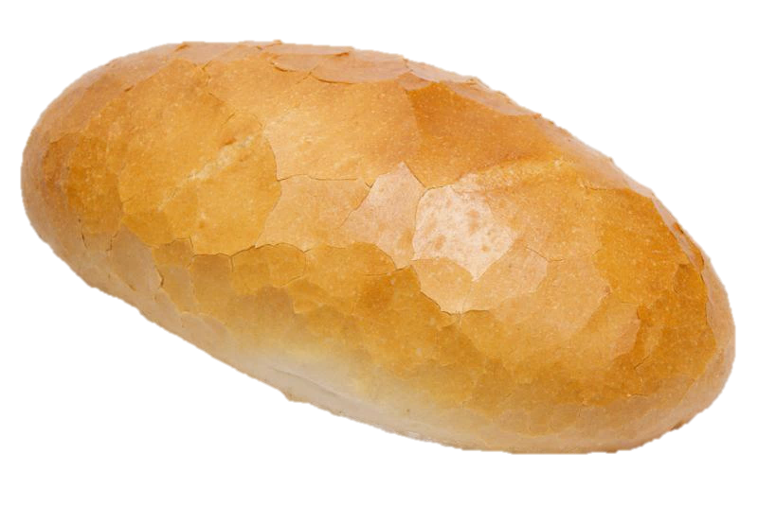

Slide 15
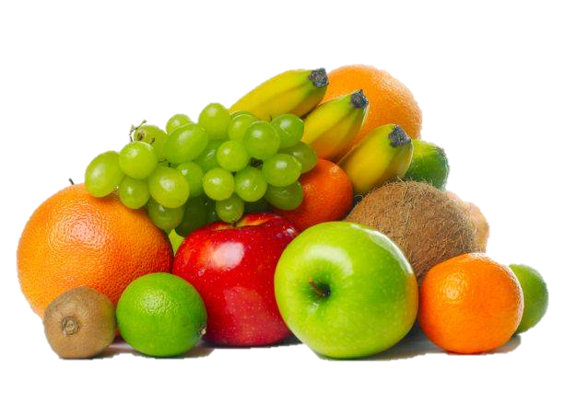

Slide 16
I’m sure that you don’t want to look like that ;)

Slide 17
WHAT ABOUT DRINKS?
Fresh juices

Slide 18
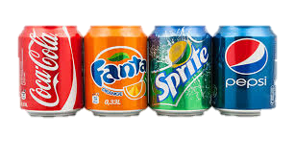
Water with fruit

Slide 19
WE hope that now you will eat more carefully than before.
Presentation made by Justyna Słonka and Alicja Sałamun

